Slide 1
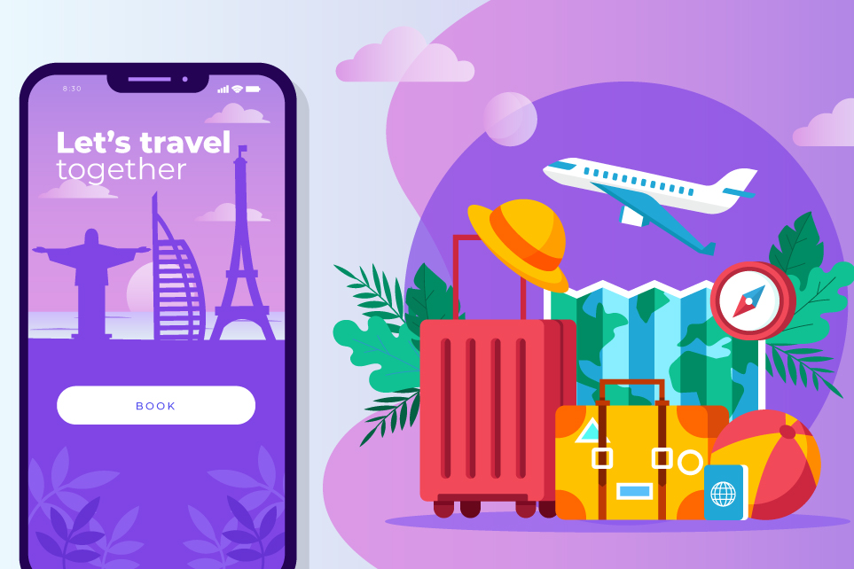
REAL LIFE LAB (RLL) PROJECT
PROJECT NAME : iMyTravel App
GROUP
10
Presented By :
1. Paturu Lavanya (2587071)
2. Pisini Pradeep (2587728)
3. Prajnaparimita (2587403)
4. Prasad Reddy (2586979)
5. Pushpa H R (2587833)
6. Ragul (2587029)
7. Ravuru Ashok (2587557)
8. Rishabh Saxena (2587626)

Slide 2
CONTENTS
Title
Contents
Modules
Objective
Introduction
Database schema
Admin and user components
Software requirements
Imytravel app
Testing reports
Conclusion
Thank you

Slide 3
MODULES
Name | Domain | Modules
1. Paturu Lavanya | FSD User | User Dashboard
2. Pisini Pradeep | FSD Admin/User | Welcome Page & Postman Testing
3. Prajnaparimita | FSD Admin | Admin Dashboard
4. Prasad Reddy | FSD Admin | Travel Experience & Comment
5. Pushpa H R | FSD User | Sign In & Reset password
6. Ragul | FSD User | Sign Up
7. Ravuru Ashok | FSD User | Add Tour
8. Rishabh Saxena | FSD User | User Profile

Slide 4
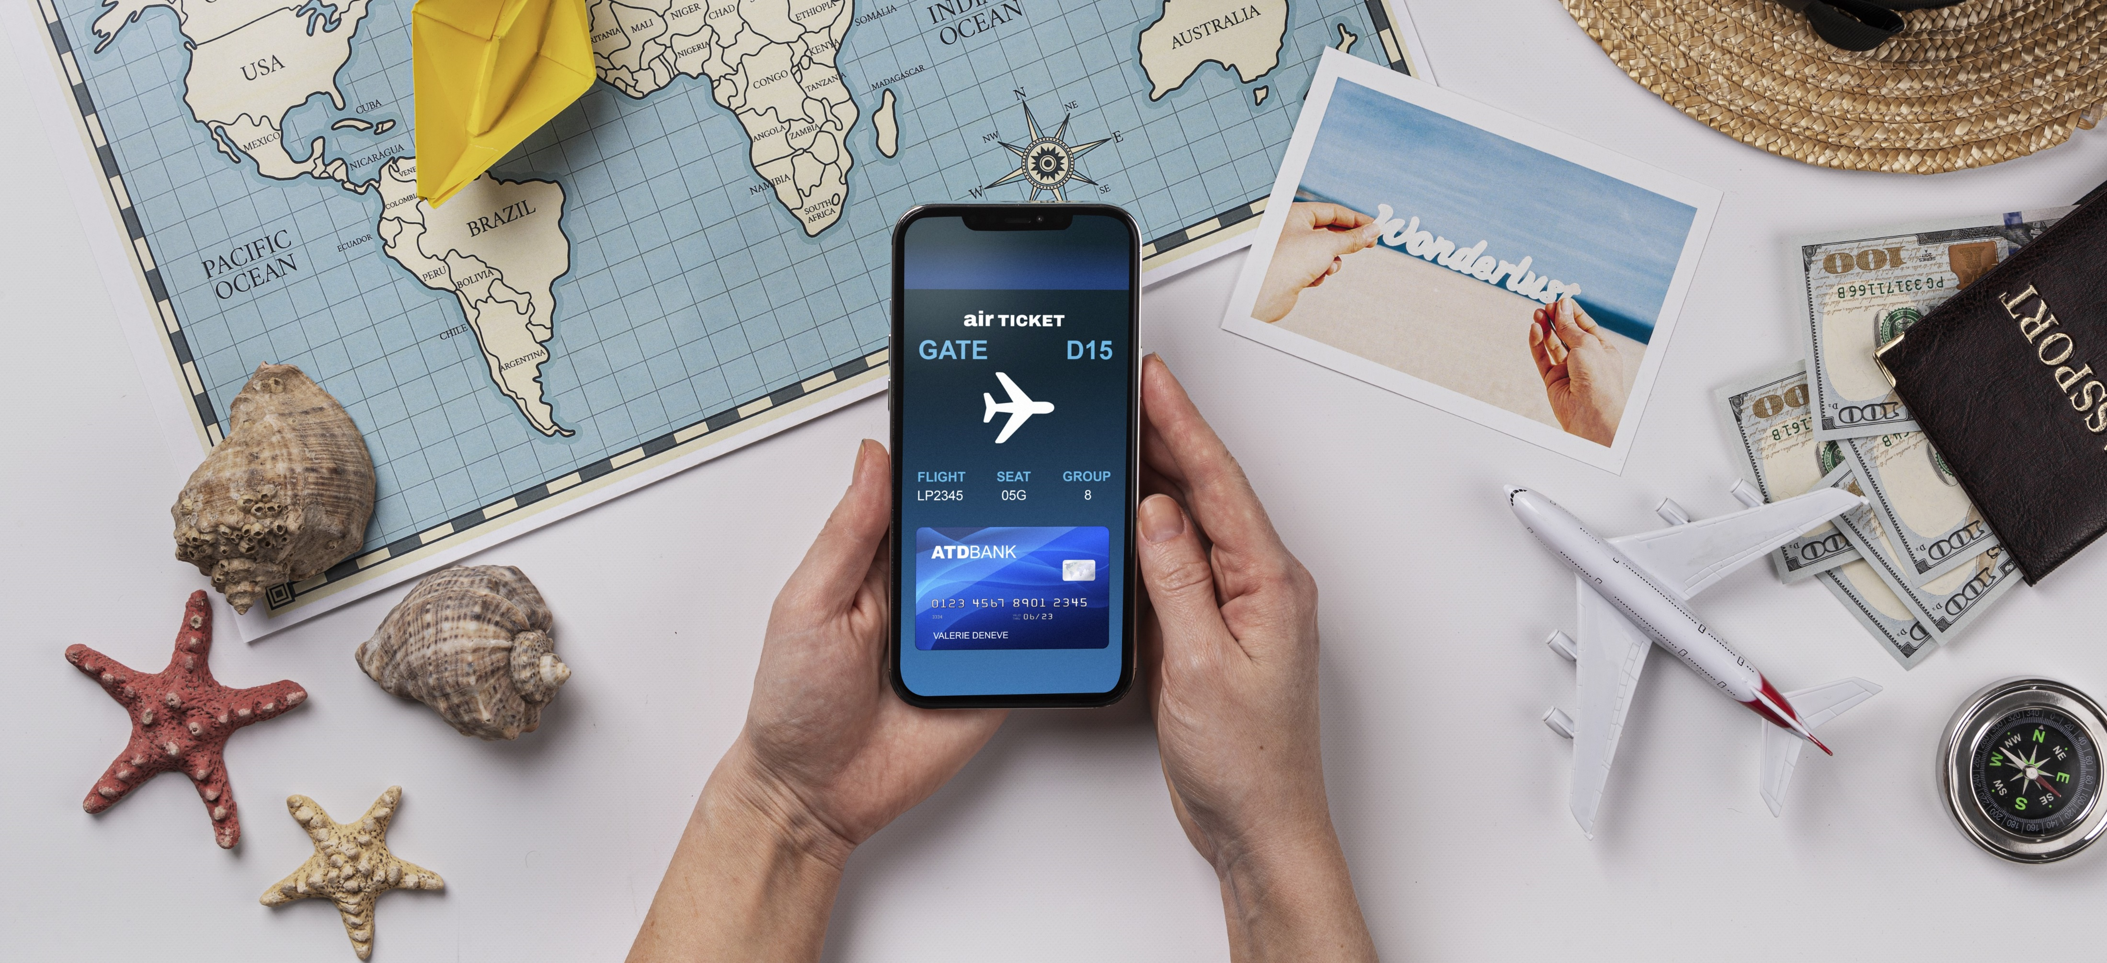
INTRODUCTION
iMyTravel App has two parts
i.Admin
ii.User
The Admin Section is like the control hub of our Application, giving users to explore the experiences of others.
Users can create personalized accounts, conveniently review, and explore the other users experiences with detailed descriptions, cost , climate and etc.

Slide 5

OBJECTIVE
Comfortable for users
User-friendly
Flexible
Informative
Responsiveness
Consistency

Slide 6





Database: MySql Workbench Back-end: Spring Boot Suite Tool / Eclipse IDE Front-End: Angular With VS-Code Testing: Postman Tool
SOFTWARE REQUIREMENTS

Slide 7
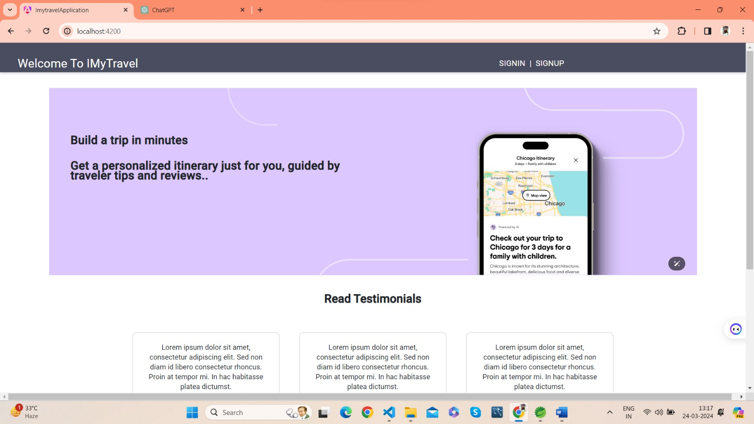
At welcome page we can access sign in and sign up Pages.
WELCOME PAGE

Slide 8

ADMIN AND USER COMPONENTS

Slide 9
ADMIN COMPONENTS
Welcome page
Admin Registration
Admin Login
Reset Password
Admin Dashboard
Add comments
Delete user comments

Slide 10
USER COMPONENTS
User register
User login
Reset Password
User dashboard
User profile
Place suggestions
Travel Experiences
Comments

Slide 11
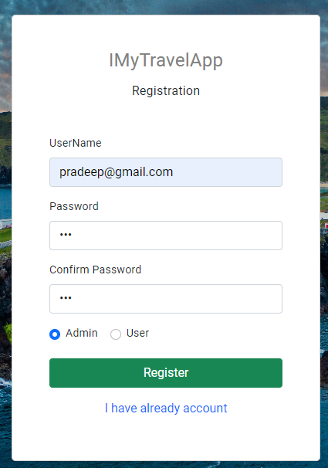
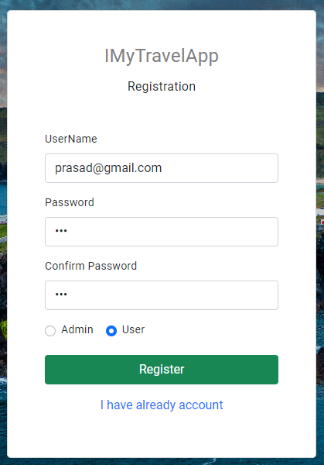
SIGN UP
In sign-up page the admin and users can able to register their profile by giving the user name and password.
If you want to enter into profile we need to create profile for admin/user.

Slide 12
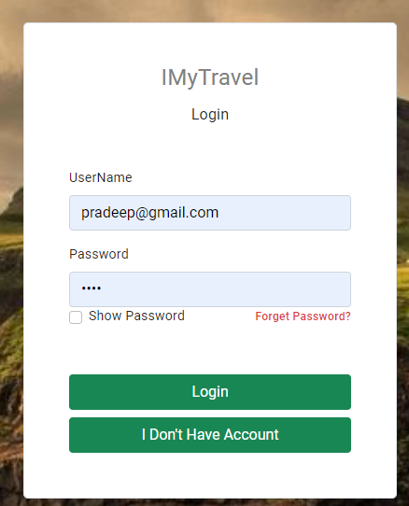
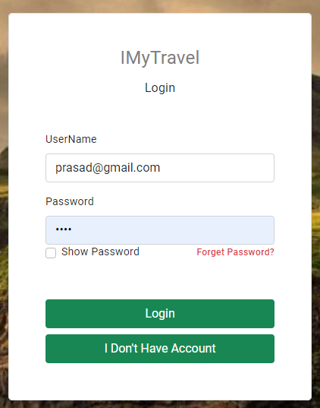
SIGN IN
In this page the admin and user can able to login to their profile using their credentials.
If the credentials doesn’t match then it shows an error.

Slide 13
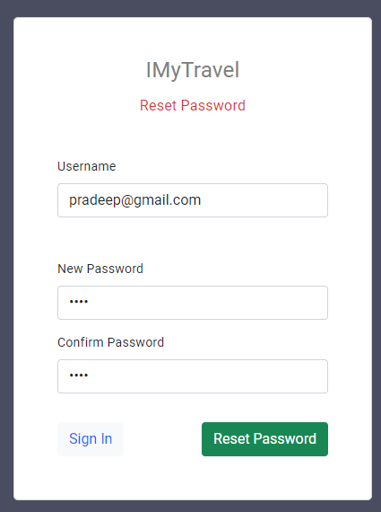
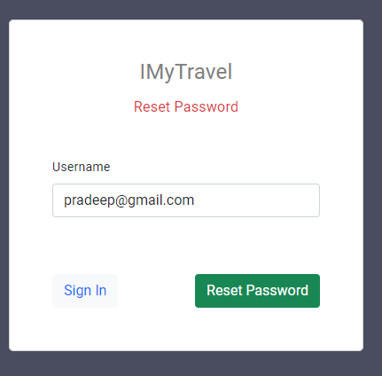
RESET PASSWORD
In reset password module the user and admin can reset the password by using their user name.
In Rest Page, the user & admin can give their email address for resetting password

Slide 14
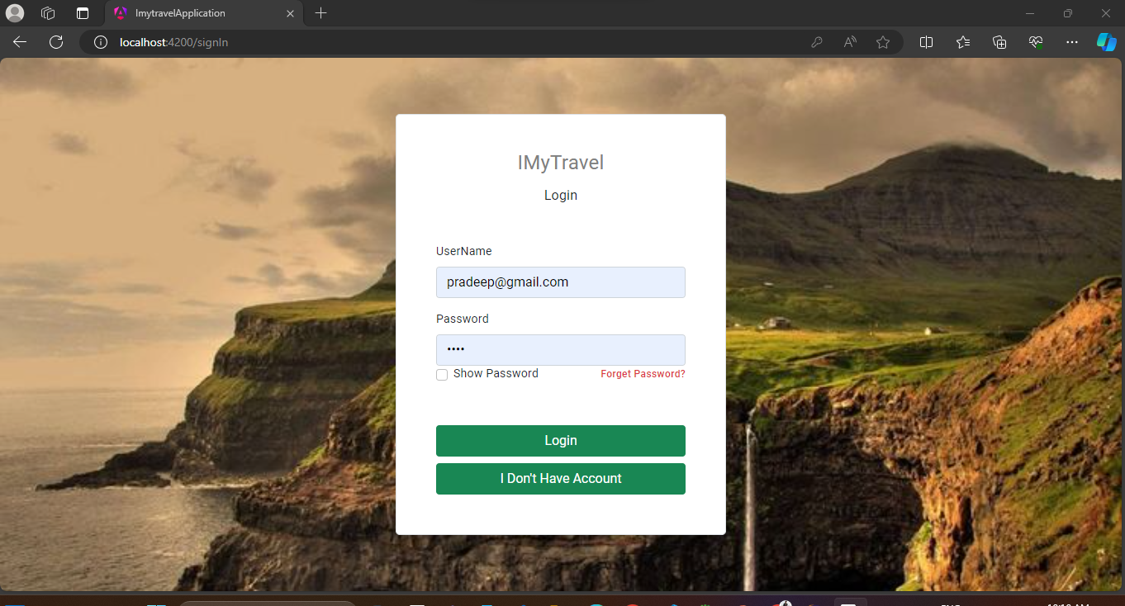
ADMIN LOGIN
Admin login is to validate admin credentials.
If credentials are matched, it will redirect to Admin dashboard
If we enter wrong credentials system will give message invalid credentials.

Slide 15
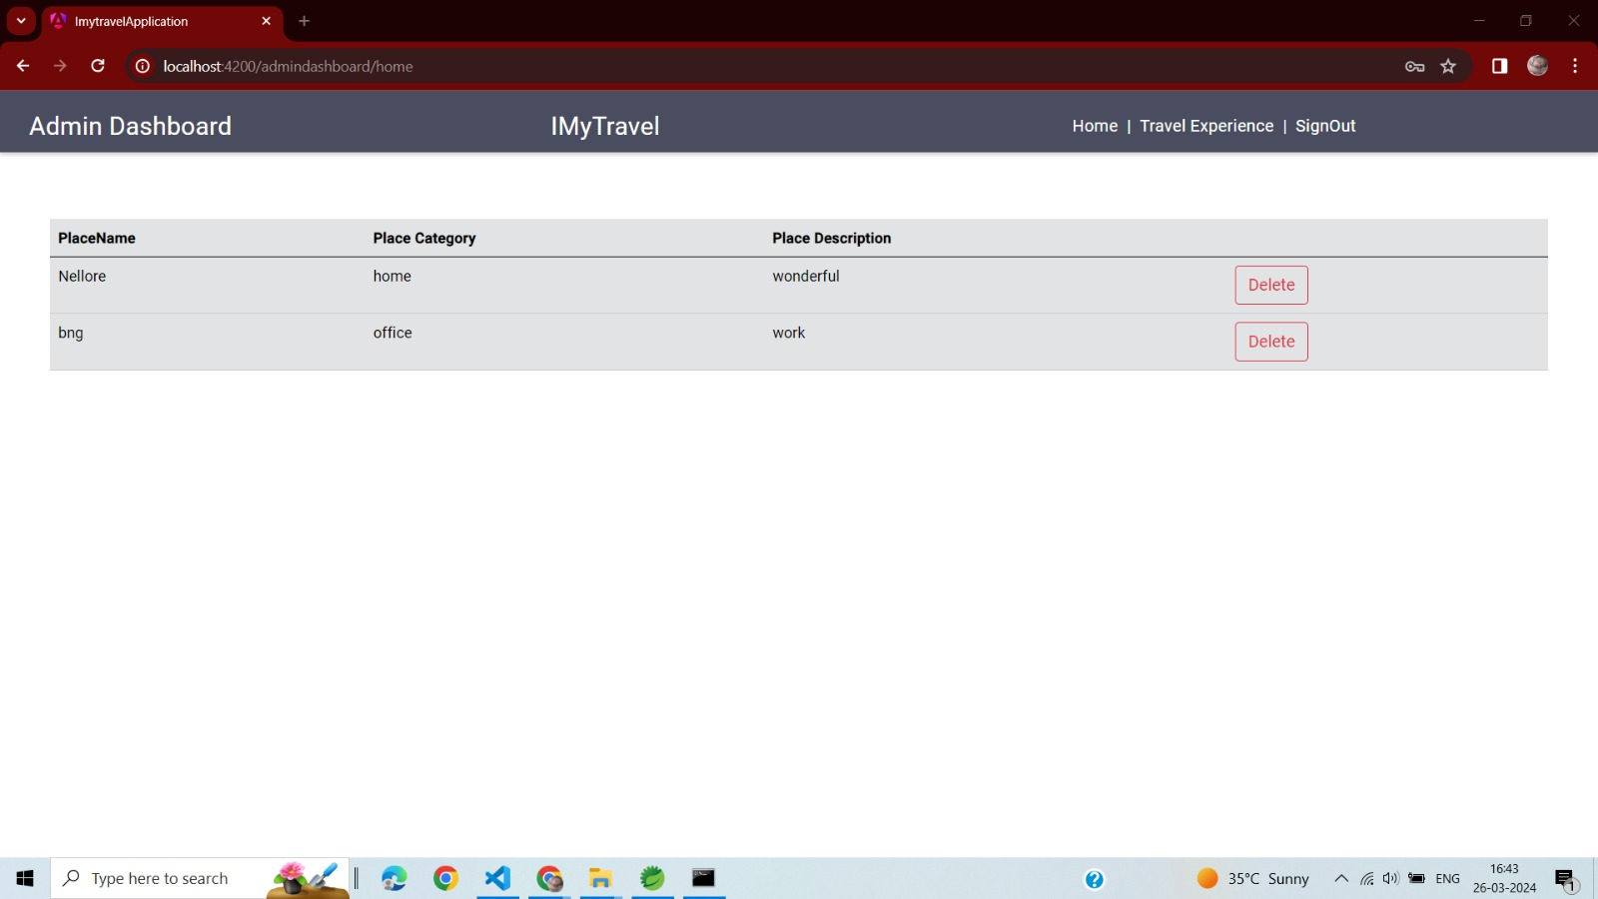
In this page admin can see all users added details like image, cost of travel ,Heritages ,Place to visit , Accessibility ,Transportation etc Also Admin can delete place detail also edit the comments
Admin Dashboard

Slide 16
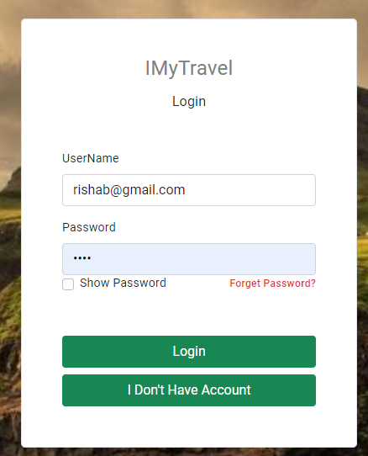
USER LOGIN
Here, The user first want’s to log-in and then go for the User Dashboard.

Slide 17
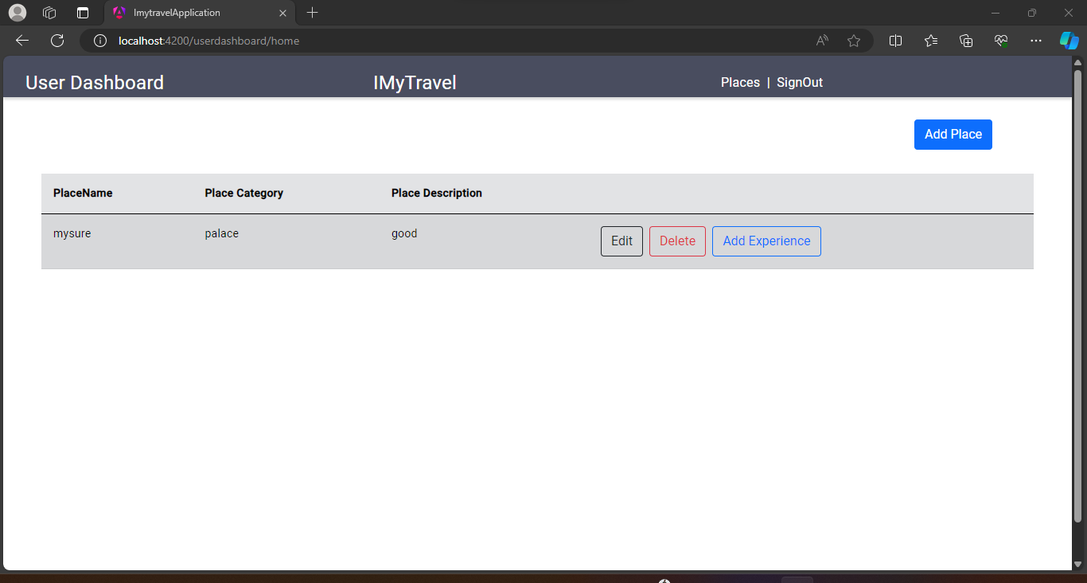
USER DASHBOARD
On successful User login, redirected to User homepage/Dashboard.
In that page the user can able to add their travelled place and place category by clicking Places button. User also can able to sign out by clicking Sign out button

Slide 18
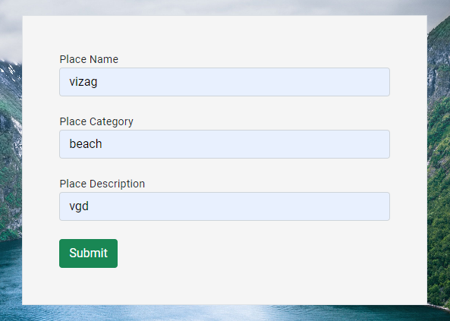
PLACE SUGGESTION
If the user can travel the world anywhere and he can choose the place suggestion in this place suggestion.
By the user references the others can see the suggestion places to visit and then go to that places.

Slide 19
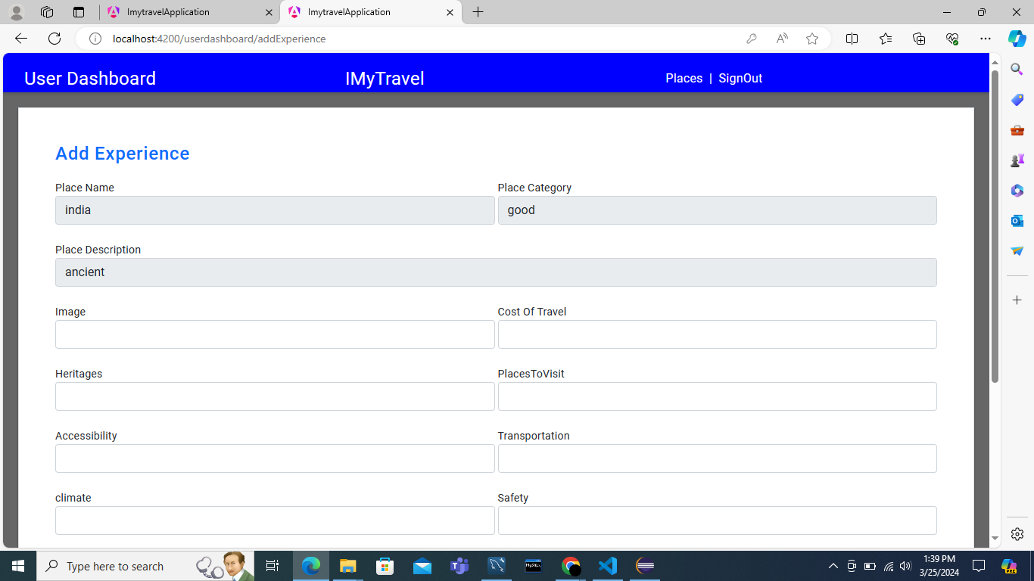
ADD EXPERIENCE
The User can explore their Travel Experience.
User Can Add the Cost Of travel And Add the travelling pictures and Some near places to visit.

Slide 20
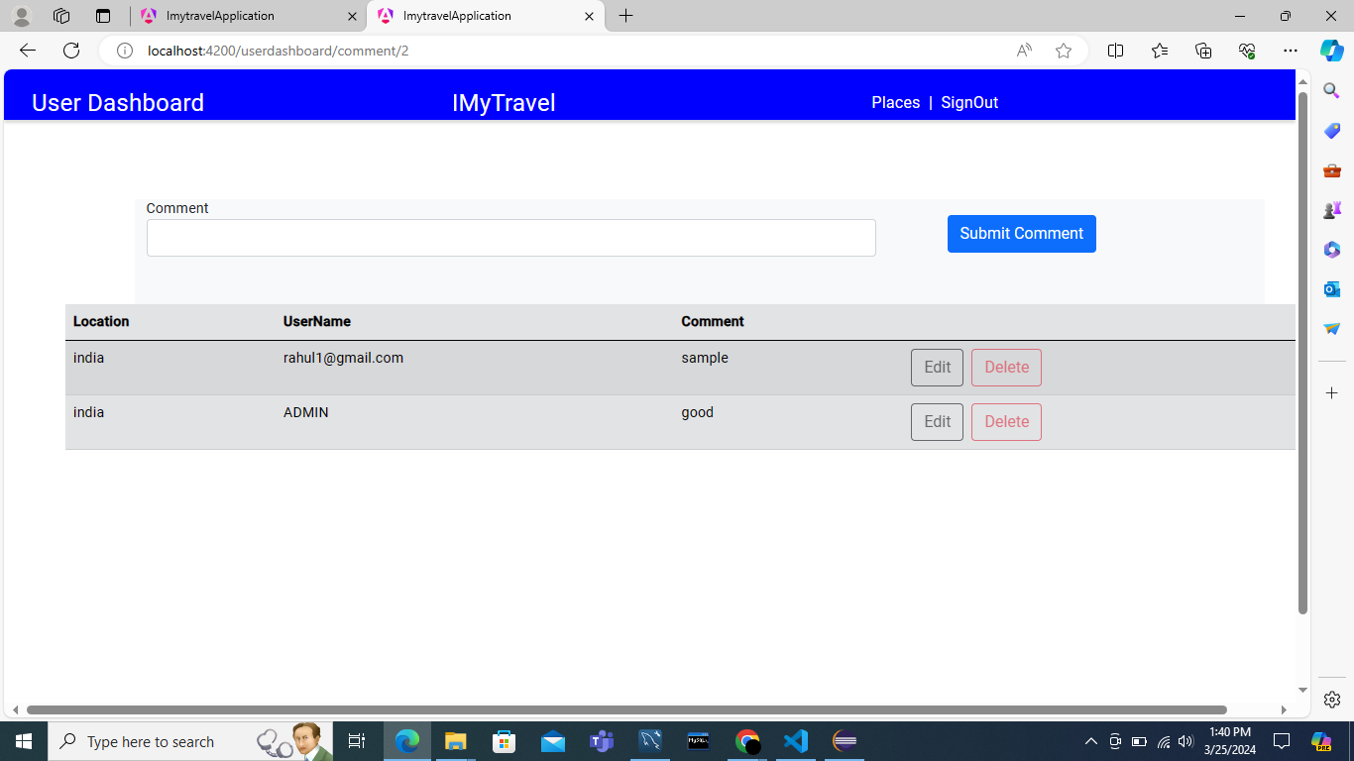
User Comment
Input fields for place name, Place Category and description.
Options to Edit, Delete, or Add experience of each place.

Slide 21
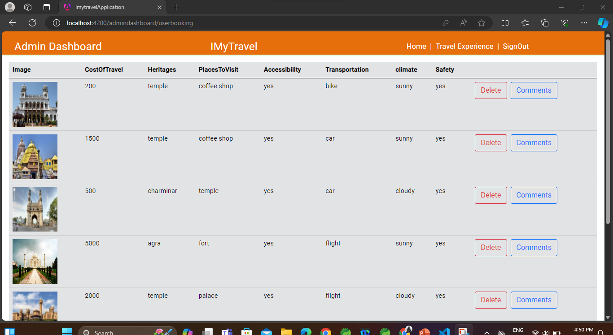
Travel Experience
In travel Experience Admin can view the user travel experience
Admin can delete the travel experiences of the users

Slide 22
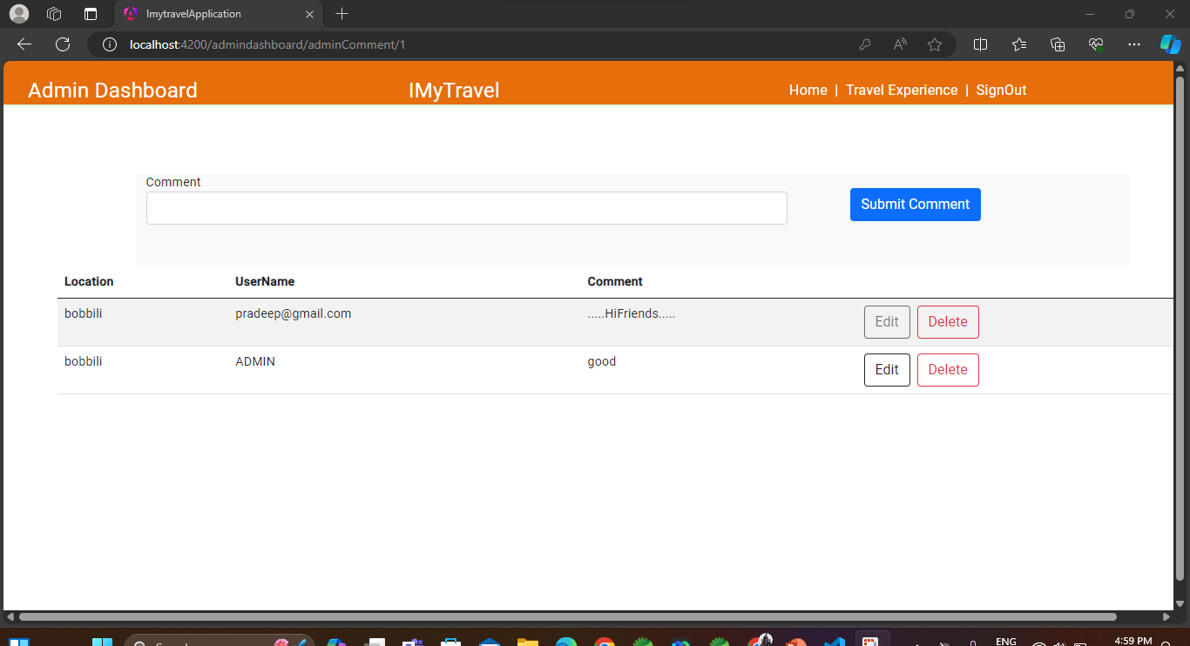
Admin Add Comments
Admin can delete comments
of users
Admin can add new comments
To the travel experience

Slide 23
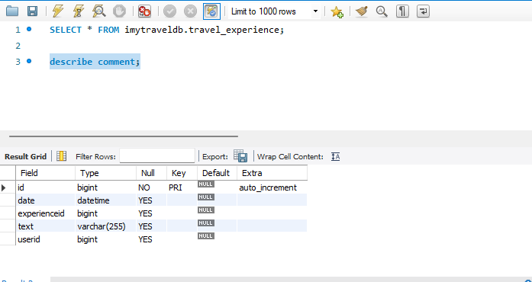
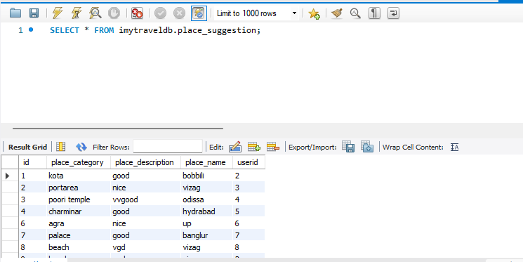
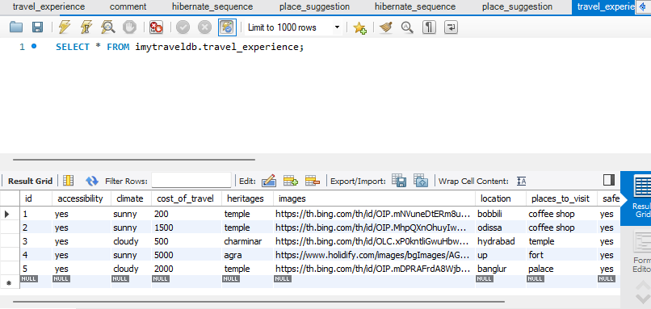
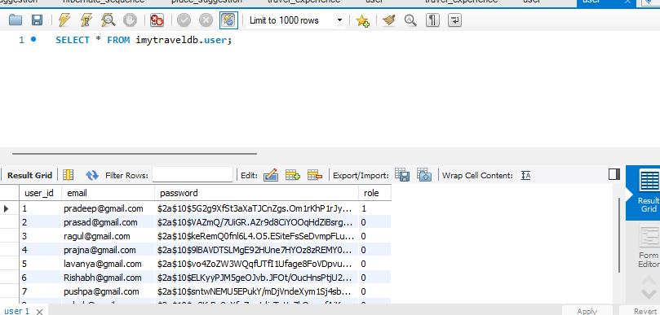
DATABASE SCHEMA
Comments
Place_Suggestion
Travel_Experience
User

Slide 24

POSTMAN TESTING REPORTS

Slide 25
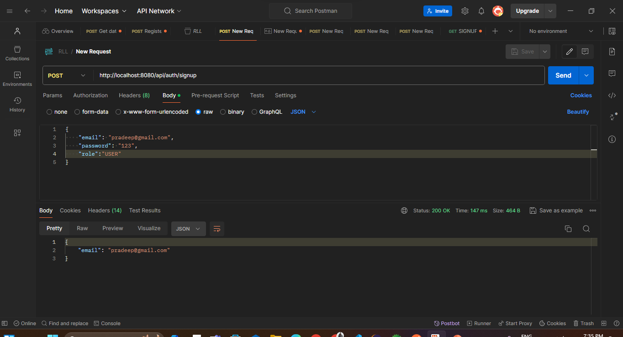
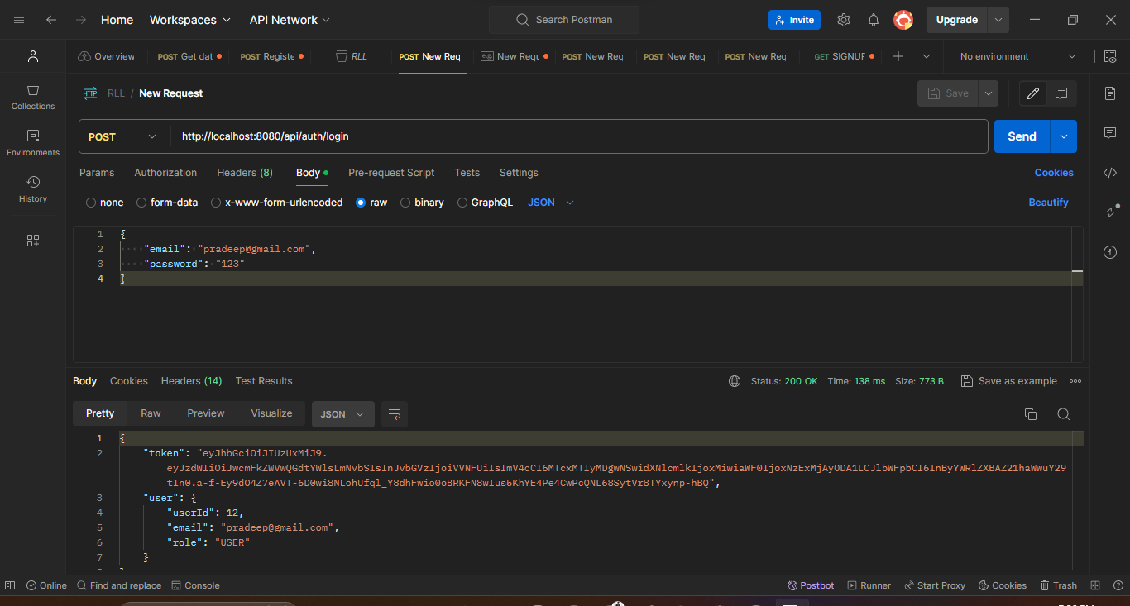
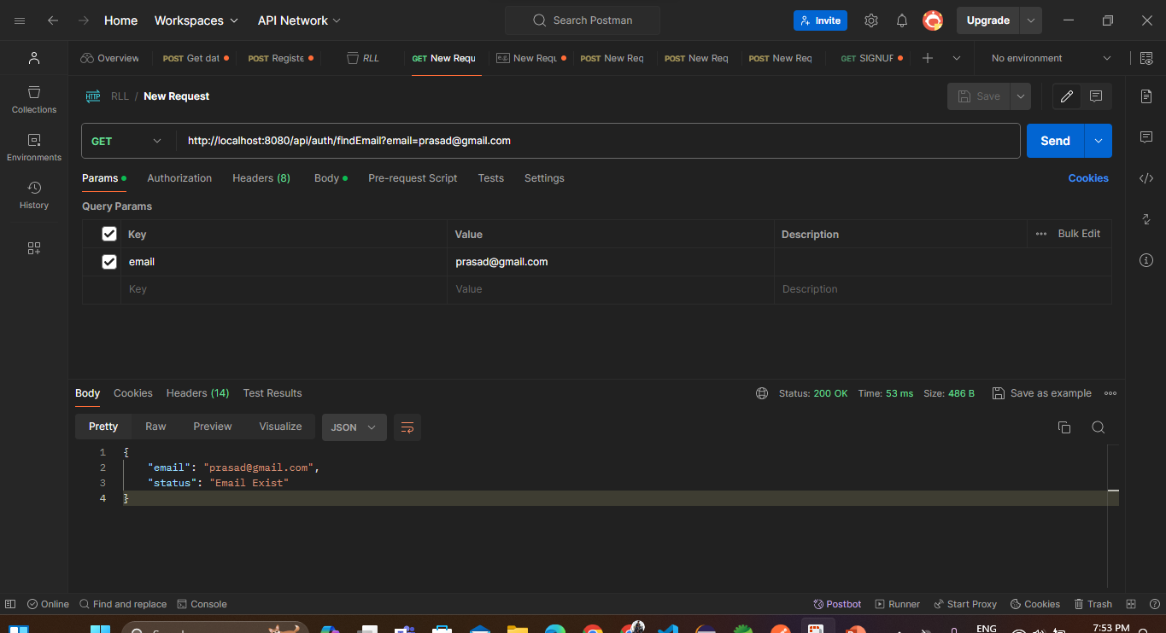
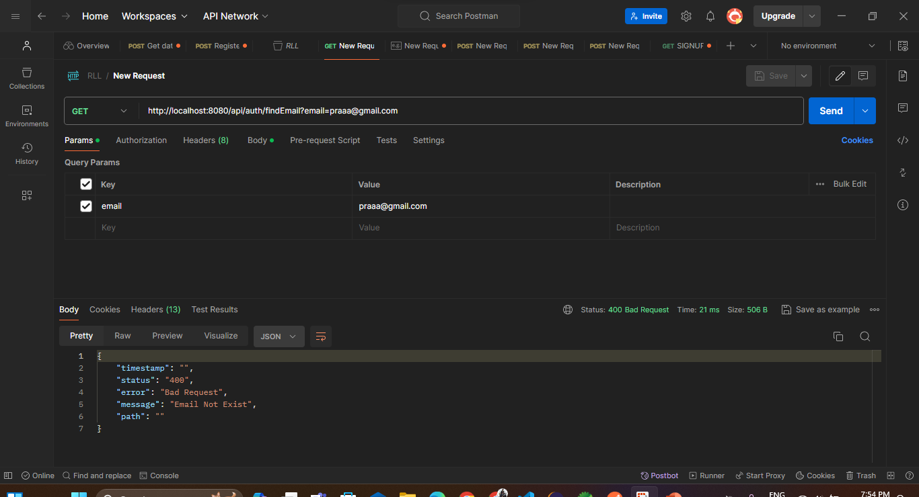
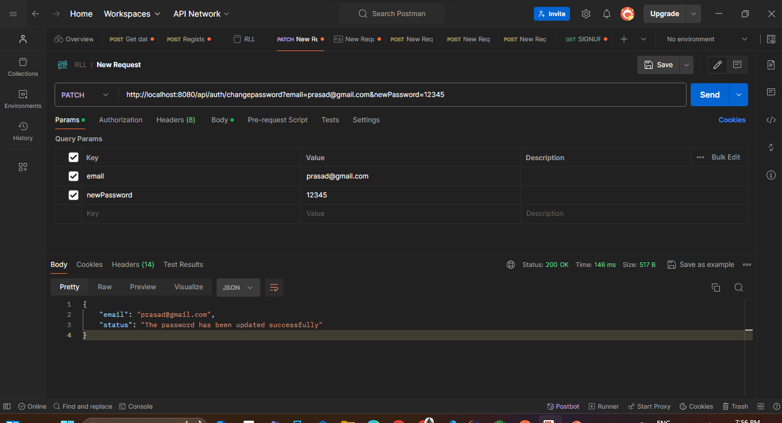
USER
Signup
login
FindEmail
Email NotFound
Change password

Slide 26
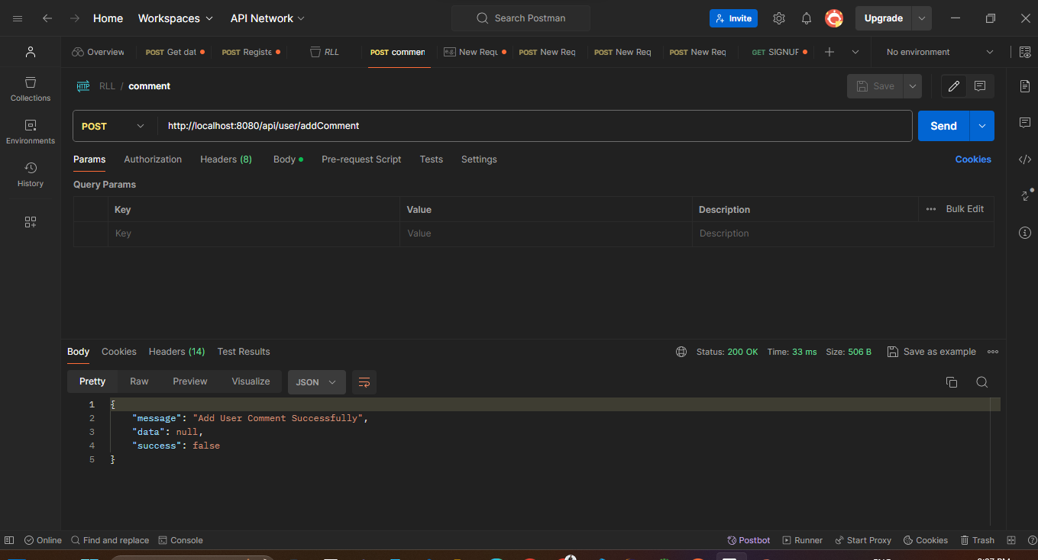
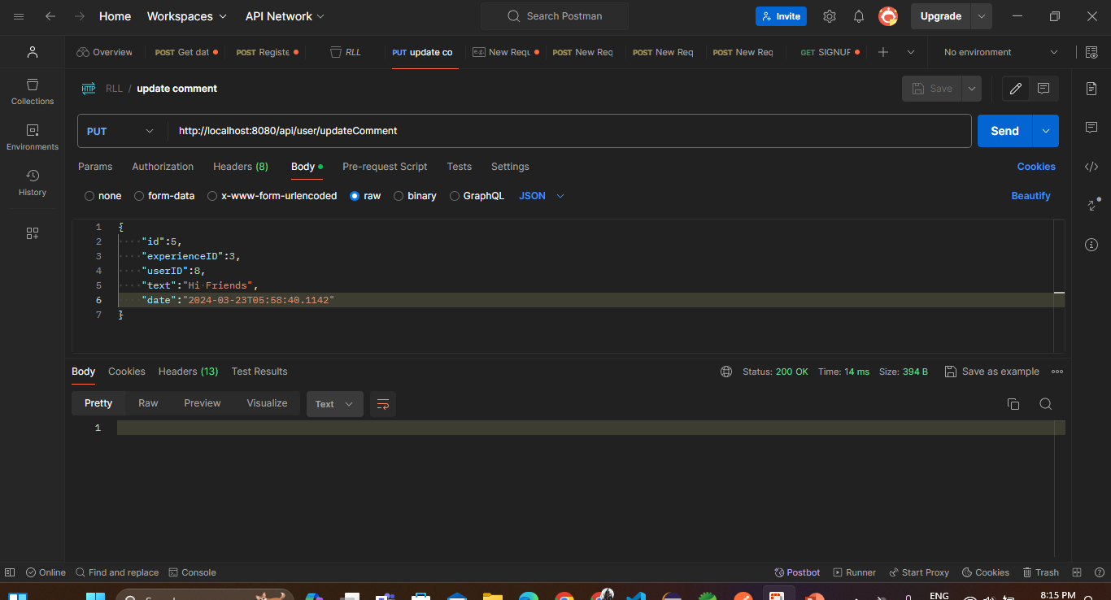
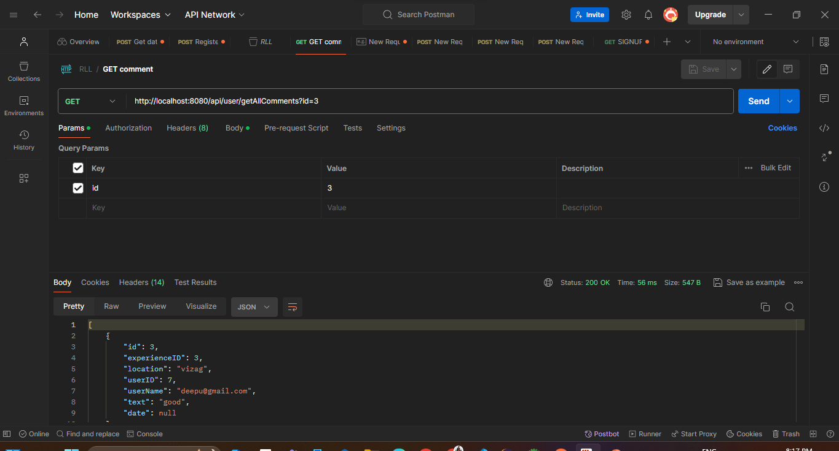
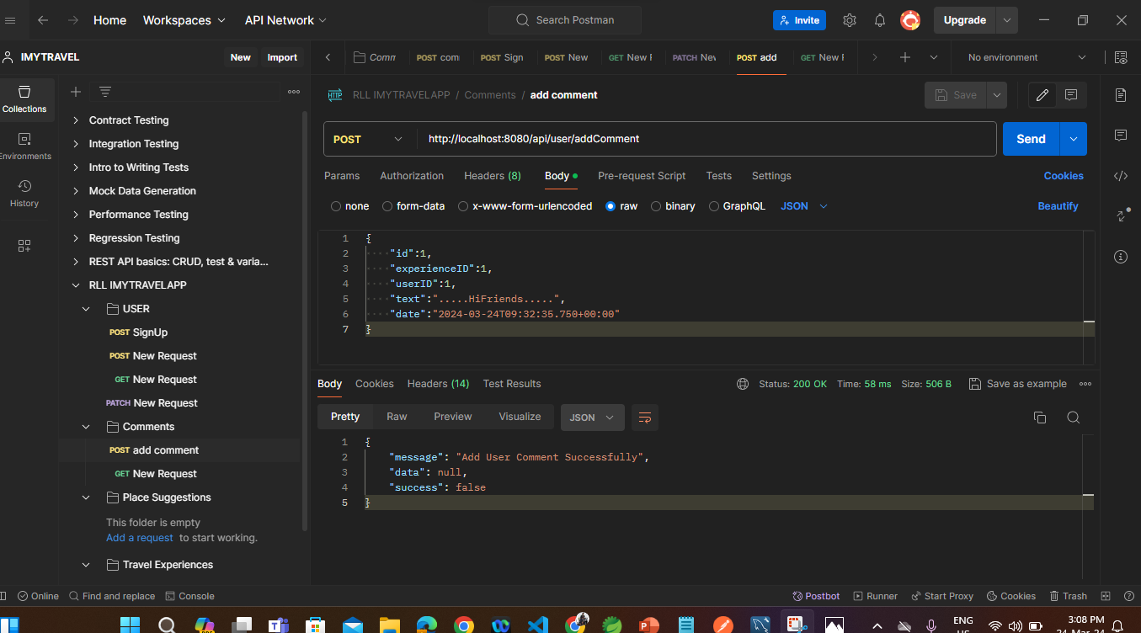
COMMENTS
Add comment
Update comment
Get comment
Delete comment

Slide 27
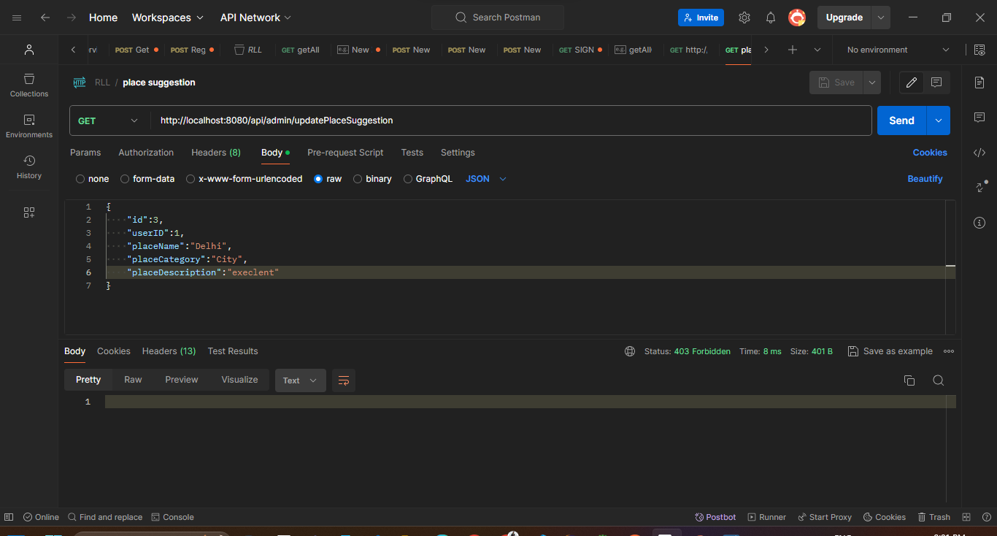
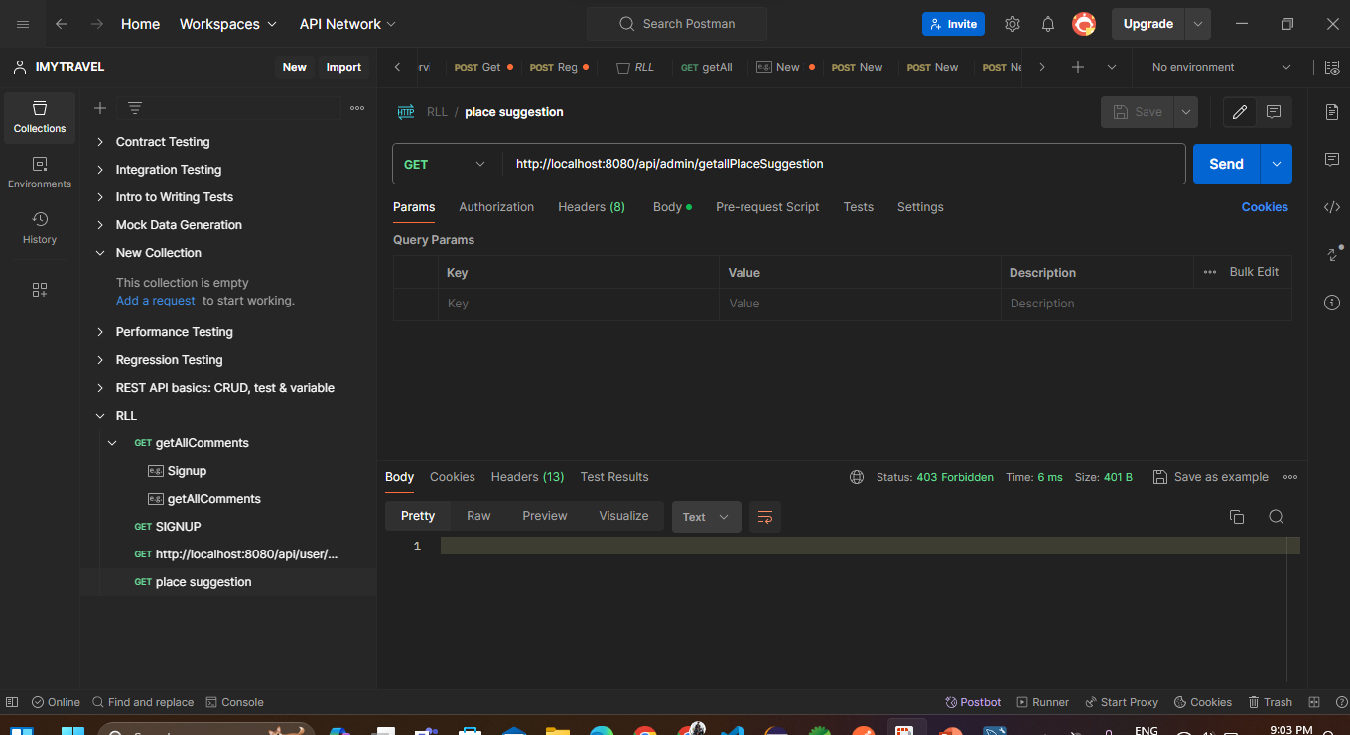
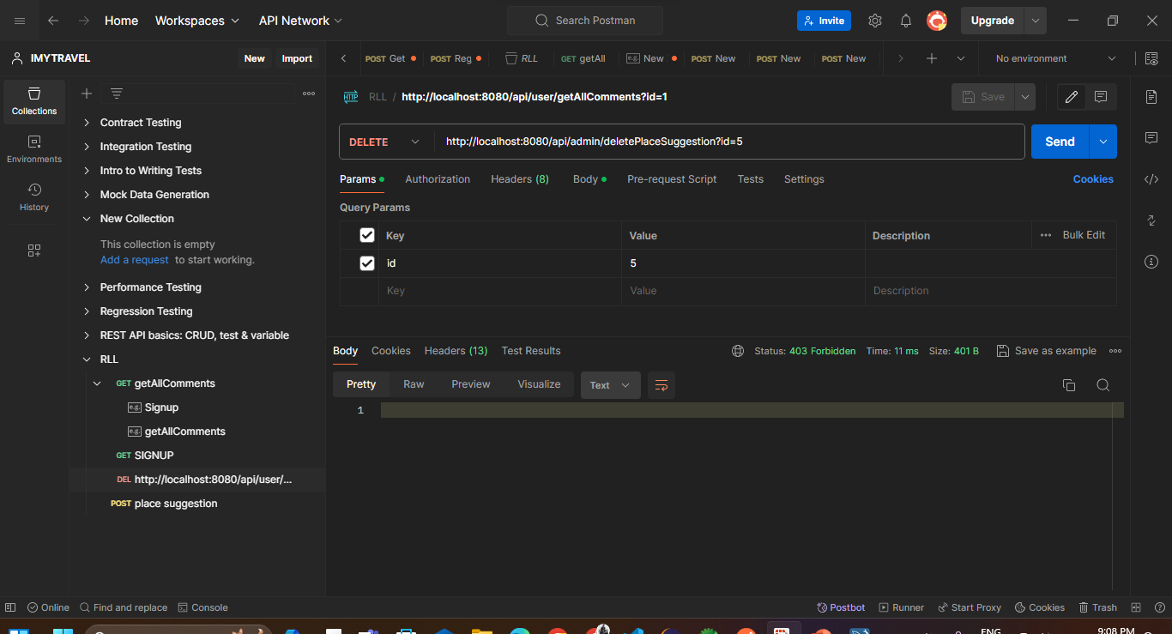
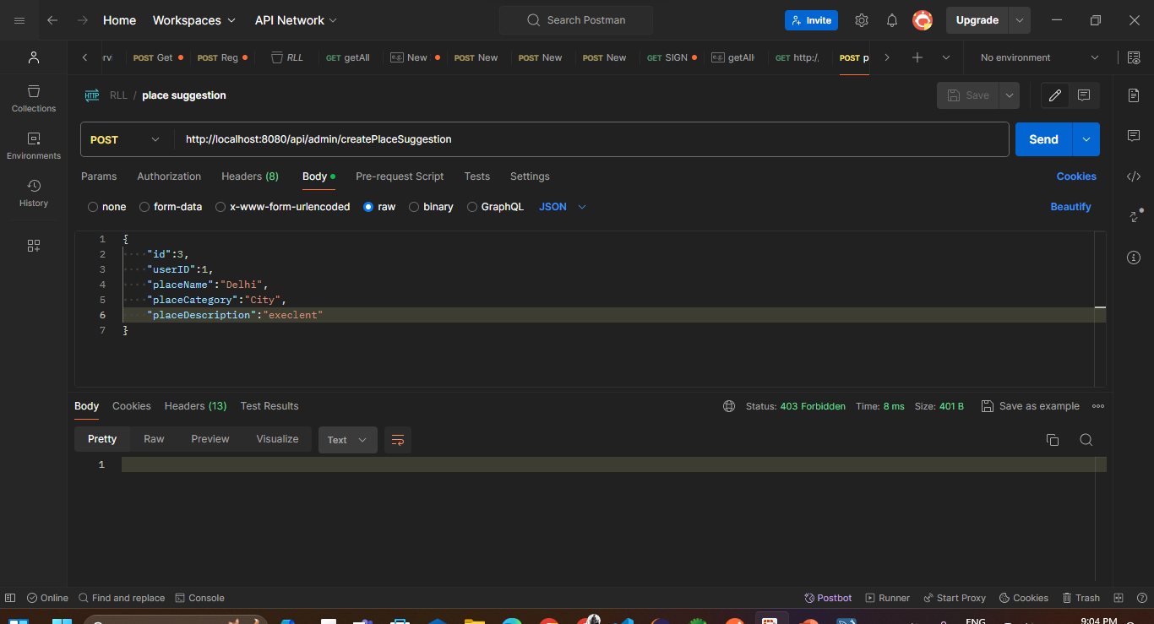
PLACE SUGGESTIONS
Update place
Get place
Delete place
Create place

Slide 28
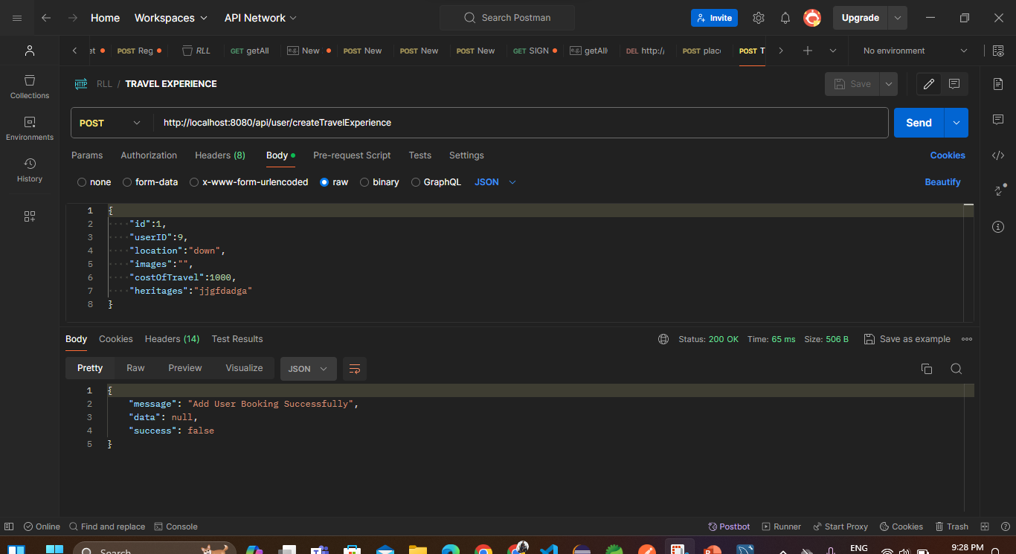
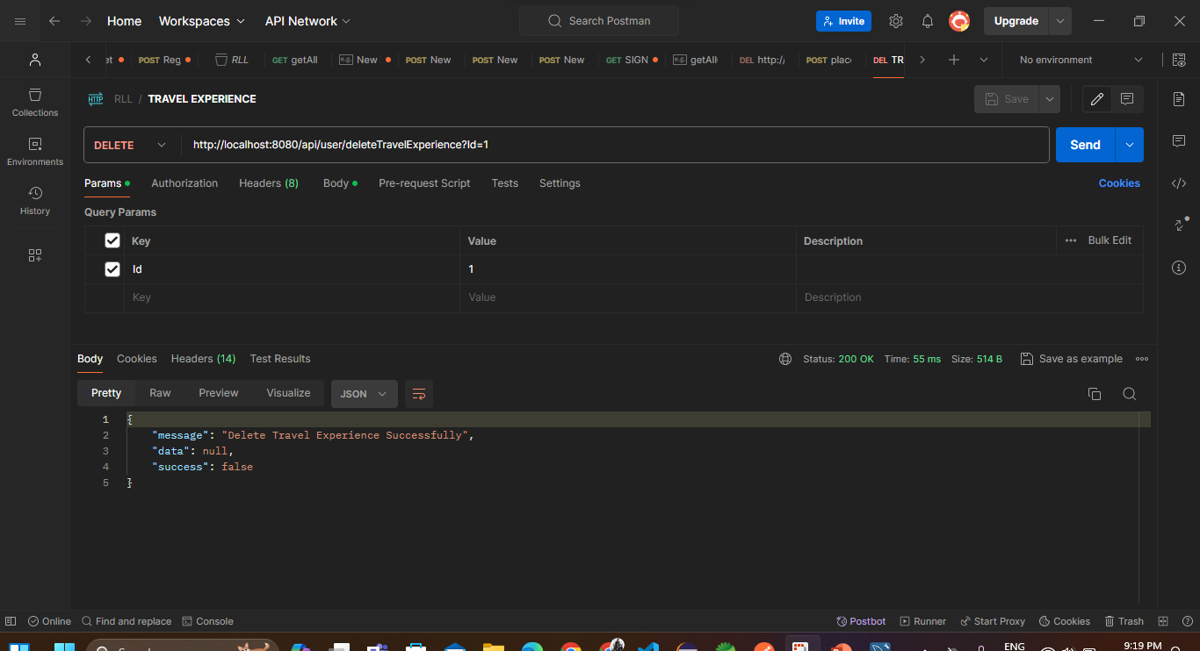
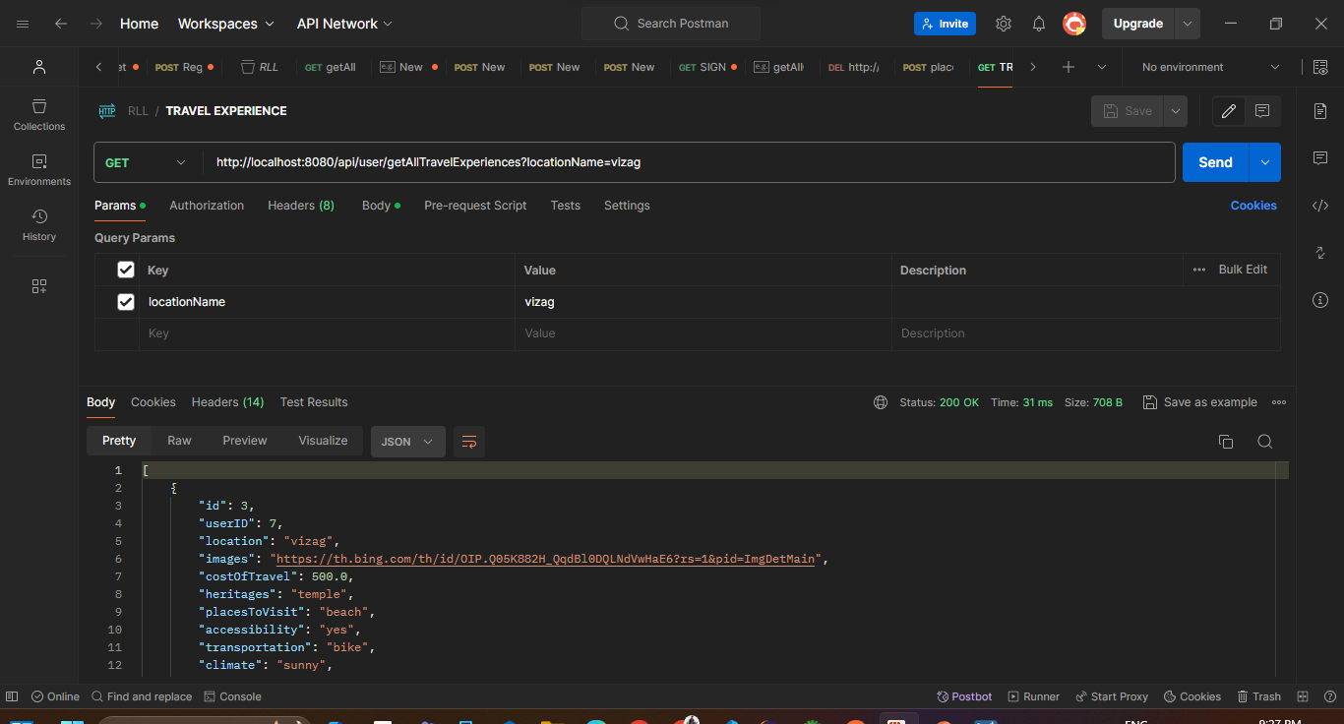
TRAVEL EXPERIENCES
Update Travel
Create Travel
Delete Travel
Get Travel

Slide 29
CONCLUSION
The iMyTravel Application, consisting of both the User and Admin sections.
Admin section provides a travel experiences , comments and place suggestions of the users and admin can add their own travel experiences.
The User section allows individuals to create personalized accounts, add their own travel experiences, comments of the places which they visited and explore other users experiences.

Slide 30

THANK YOU !

